Slide 1
COVER PAGE
NAME:HEMANT MANJUNATH KADLER
EMAIL:hemantkadler@gmail.com
COLLEGE:VIDYAVARDHAKA COLLEGE OF ENGINEERING
BRANCH:COMPUTER SCIENCE ENGINEERING.

Slide 2
PROBLEM STATEMENT
The objective of this project is to predict customer churn in a credit card portfolio.
Churn refers to customers who stop using their credit card services.
Early churn prediction helps financial institutions retain customers and reduce losses.

Slide 3
TASK 1
Mixed data types: numerical and categorical
No major missing values
Target variable: Attrition_Flag
Existing Customer
Attrited Customer
Estimated Model Difficulty:
Medium
Reason: mixed features and class imbalance

Slide 4
TASK 2
Important features identified based on business relevance:
Credit_Limit
Total_Trans_Amt
Total_Trans_Ct
Months_Inactive_12_mon
Avg_Utilization_Ratio
Created a conditional feature:
Customers categorized as High or Low credit based on average credit limit.

Slide 5
TASK 3
Grouped aggregation performed using churn status:
Mean transaction amount
Transaction count
High-risk customers identified using:
High inactivity
Low transaction count

Slide 6
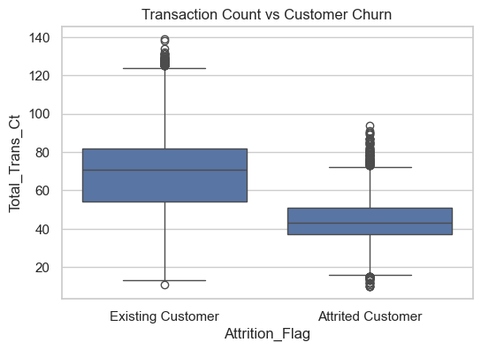
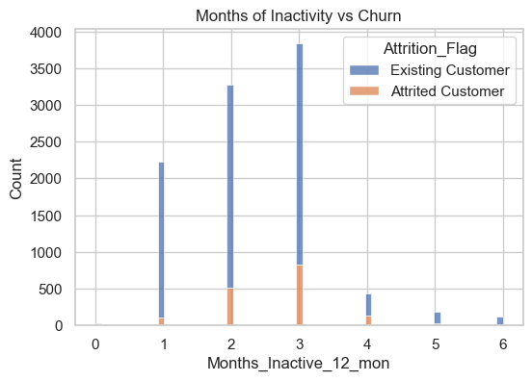
TASK 3

Slide 7

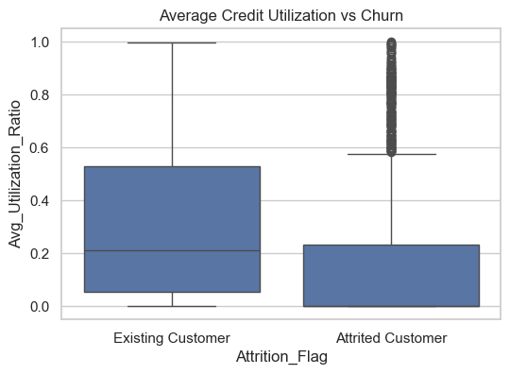
TASK 3

Slide 8
TASK 4
Chosen Model:
Logistic Regression
Why this model:
Suitable for binary classification
Easy to interpret
Fast to train
Works well on structured data

Slide 9
TASK 5
Content:
Trained model deployed using FastAPI
REST API exposes /predict endpoint
API receives customer data and returns churn prediction
Human-style line:
“This step helped convert the ML model into a usable service.”

Slide 10
PROJECT STRUCTURE

